Slide 1
ADC Basic Principle
The basic principle of operation is to use the comparator principle to determine whether or not to turn on a particular bit of the binary number output.
It is typical for an ADC to use a digital-to-analog converter (DAC) to determine one of the inputs to the comparator.

Slide 2
ADC Various Approaches
3 Basic Types
Digital-Ramp ADC
Successive Approximation ADC
Flash ADC

Slide 3
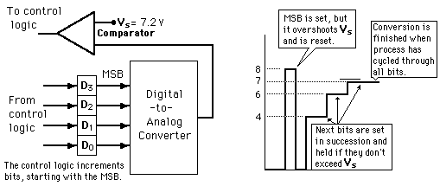
Successive approximation ADC
Illustration of 4-bit SAC with 1 volt step size

Slide 4
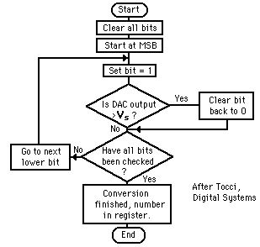
Successive approximation ADC
Much faster than the digital ramp ADC because it uses digital logic to converge on the value closest to the input voltage.
A comparator and a DAC are used in the process.

